Slide 1
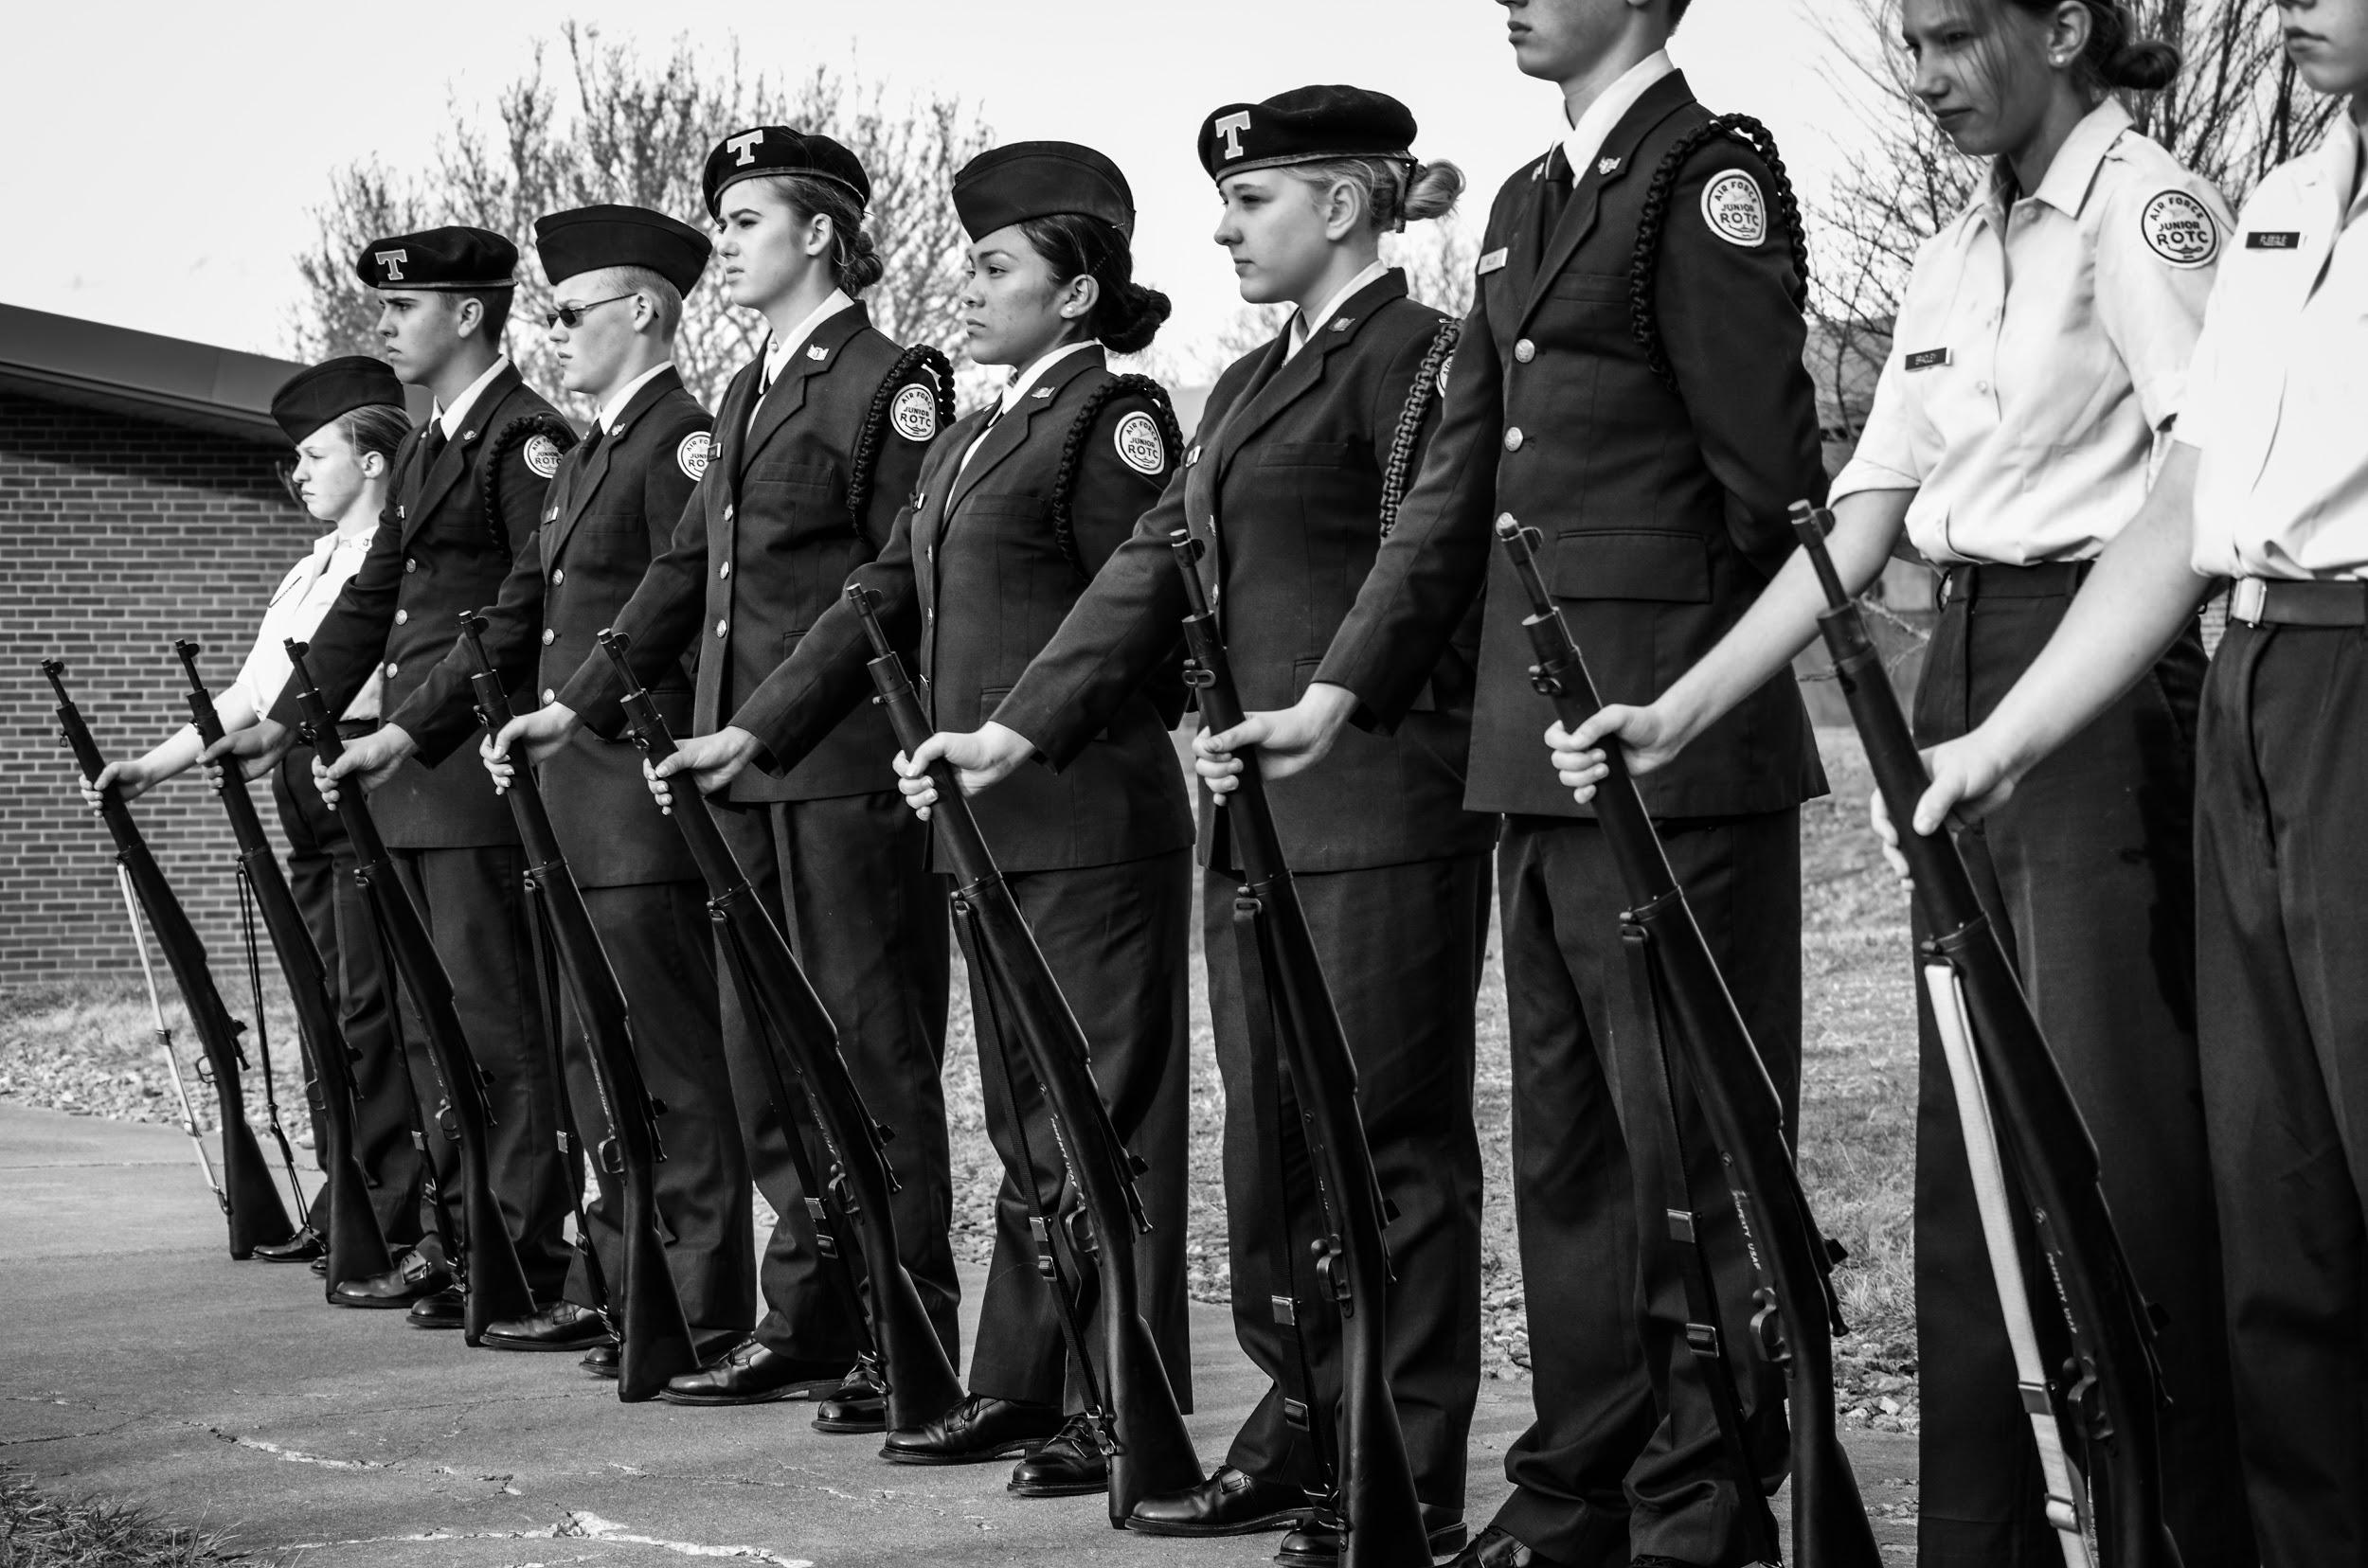
Tuscola AFJROTC
NC-075
Never Say Die!

Slide 2
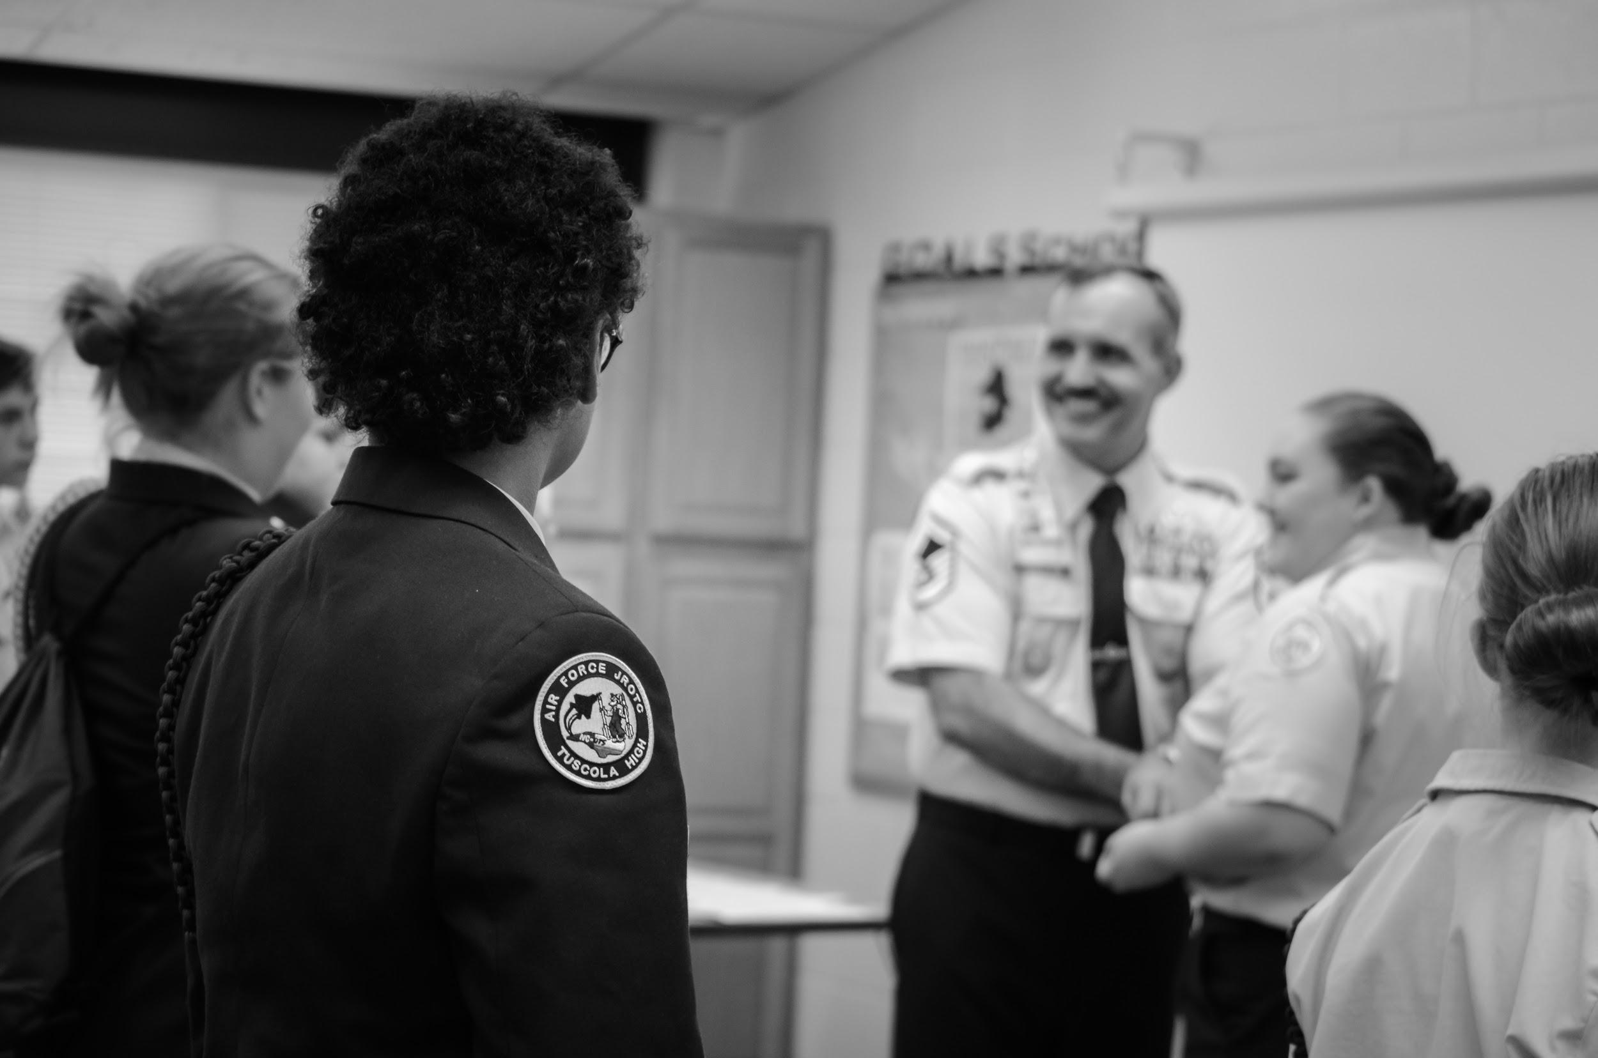
NC-075
Established in 1972 - 46 years
“Never Say Die!”

Slide 3
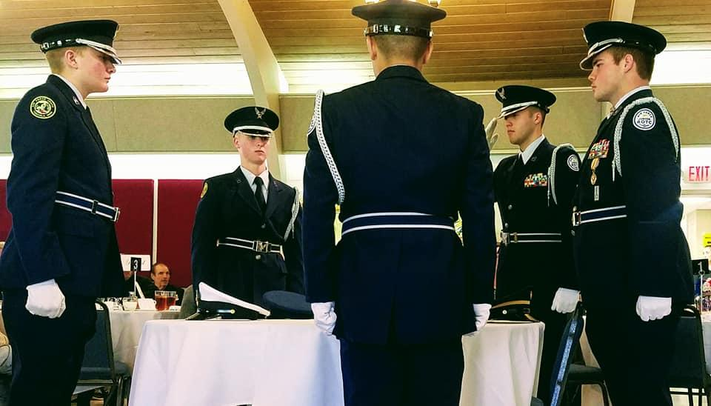
NC-075
We believe all cadets can be leaders.
cadets are expected to honor the code.
“I will NOT lie, cheat, or steal, nor tolerate those who do.”
JROTC IS MORE THAN an elective.
We are building better citizens for tomorrow.

Slide 4
Chain Of Command
Corps Commander: C/Lt Col. Jack Leslie
Deputy CC: C/Major Jonathan Delacruz
Executive Officer: VACANT
Stand Eval: C/1st Lt. Aaleiah Cagle
Command Chief: C/CMSgt Hunter Davis
First Sergeant: C/CMSgt Nick Sawyer

Slide 5
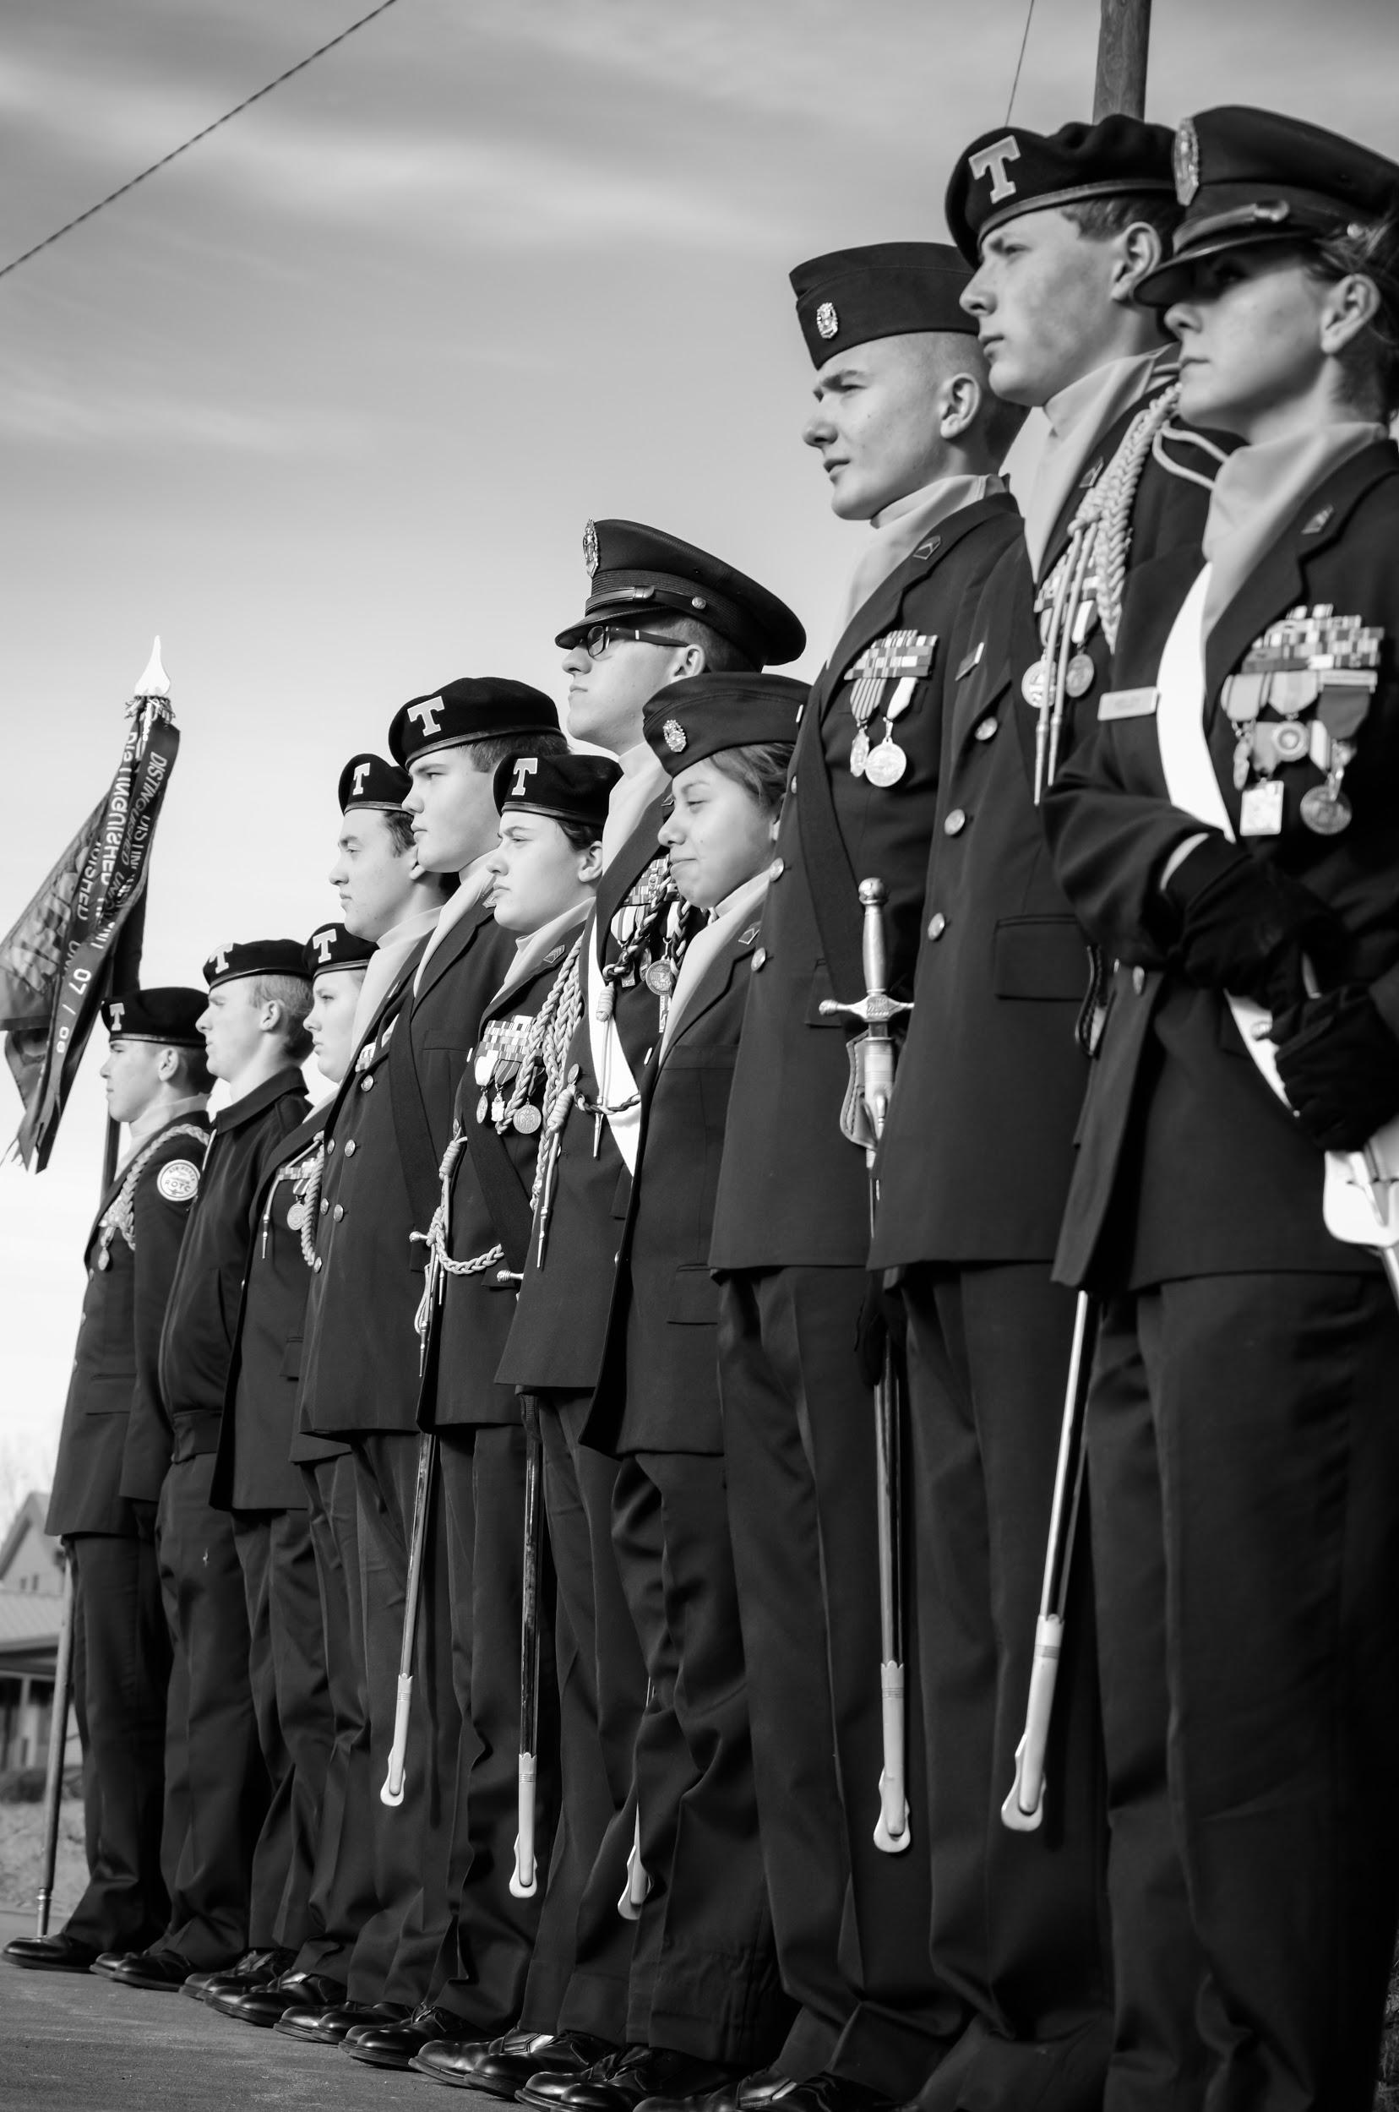
47 Years………..
Unique Opportunities
Drill Team (Marching) Kitty Hawk Air Society (Academics) Raider Team (Athletics) Marksmanship Team (Air Rifle Shooting) Video Outreach Team (Video Editing) Cyber Team (Network and Security Defense) Color Guard (Presentation Of the Colors) Helping Hands (Community Service Team)

Slide 6
Corps Impact
2018- 2019 NC-075 Goals
Raise at least $5,000 in profit through at least five fundraisers by April 1st, 2018
Have 75% of NC-075 passing their core classes by April 1st, 2018
School Impact
Conduct at least thirty-five (35) school service events for the 2018-2019 school year.
Recruit at least 50 new cadets for the next school year as well as retain at least 65 current cadets by the 2019-2020 enrollment date
Community Impact
Assist at least 10 local charitable organization in the community by April 1st, 2018
Have an average of 12 community service hours per NC-075 cadet by April 1st, 2018

Slide 7
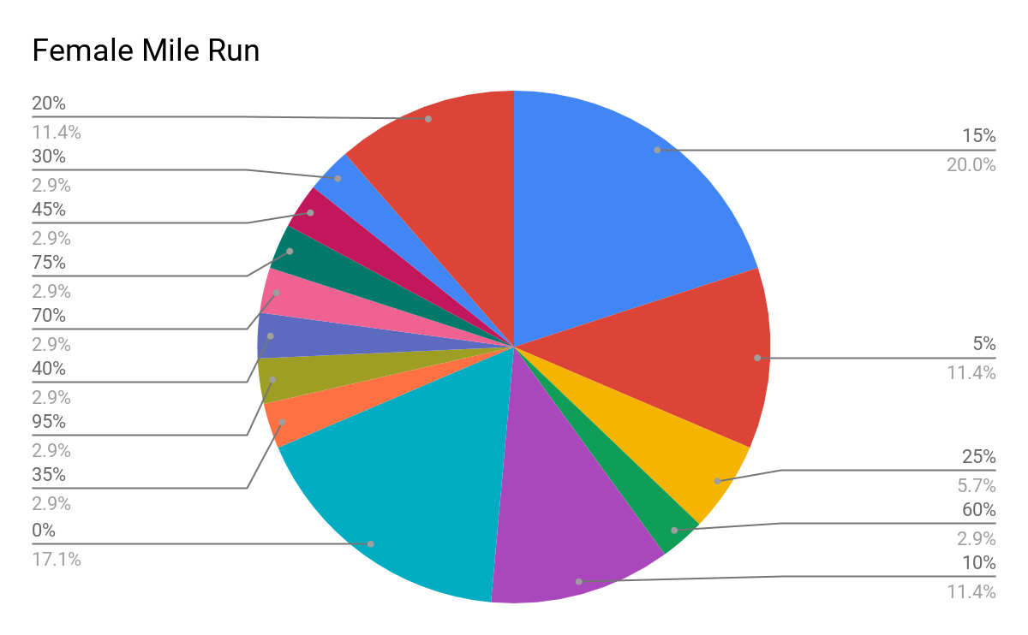
Performance

Slide 8
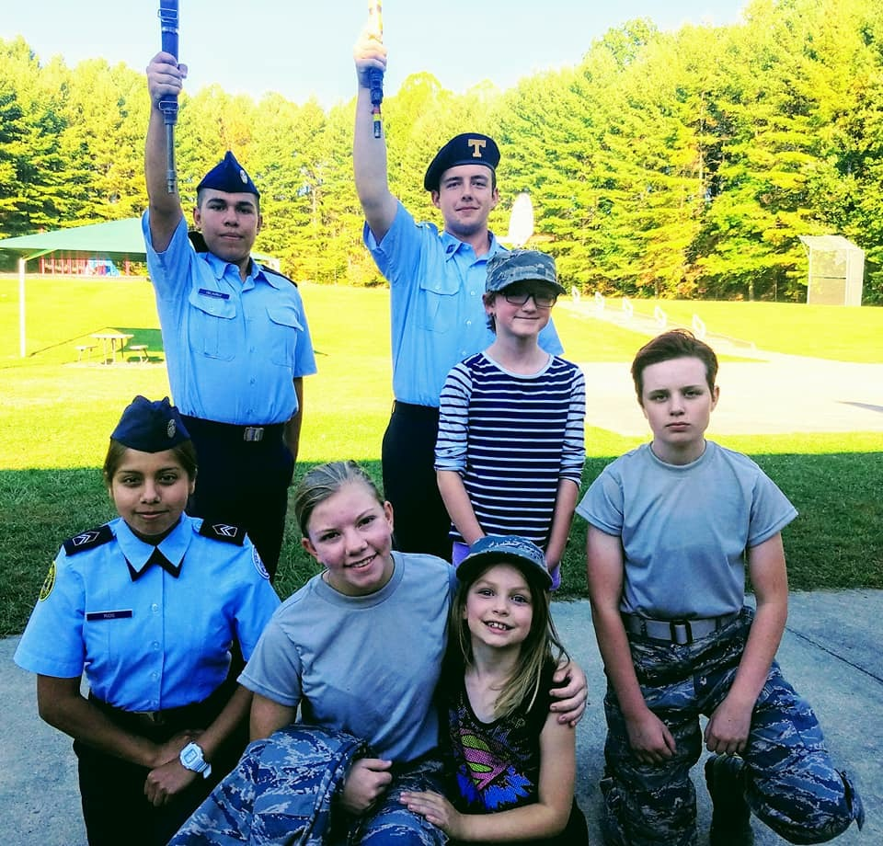
Community Service
A large part of JROTC.
We help those of the community whenever we can so that cadets can learn the true meaning of being a citizen.
We offer many opportunities to participate in these events.
Such as:
Haywood co. Apple Festival, Salvation army Bell Ringing, Wreaths Across America, Hurricane Florence Care Packages, ect.

Slide 9
Cadet Achievements
112th Annual Canton Labor Day Parade:
1st Ever NC-075 Drill Camp:
35th Annual Folkmoot parade:
Flag retirement Ceremony:
Boys Nation, 4-year Army ROTC scholarship; obtained by Jack Leslie.
NASA Camp: Jordan Smelley, Clay Payne, Cole Slater
9/11 Ceremony: Planned by Olivia Fleegle, Clay Payne.
VMI / Western Colorguard
14th Annual veterans Day Luncheon:
National Honor Society Acceptance:
Enlistment Into USAF: Jonathan Delacruz
Enlisted into ARMY:
Gage Dike

Slide 10
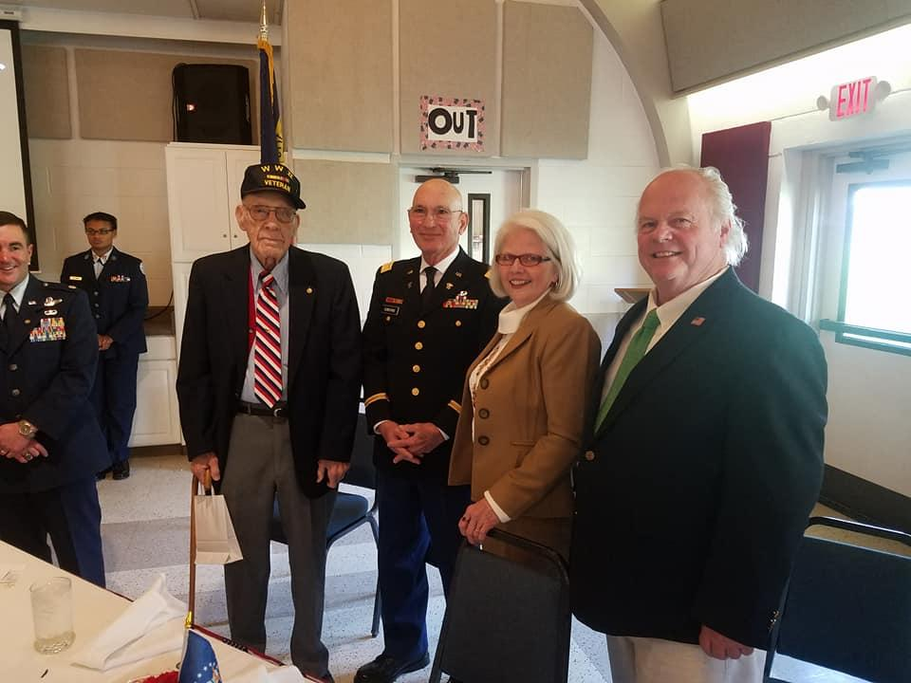
Veterans Day Luncheon
Military ball
Military Ball is held at the end of the year around the time of prom. The events that happen at this event are formal and well organized. This event is the top event to enjoy. It begins as a strict and formal event but it does trickle down to an energetic and fun time.
Our 15th Annual VDL.
We provide a free lunch to our local veterans.
You have the opportunity to sit and actually talk to a one of our local heroes who served our country.

Slide 11
20 Cadets - Sports (Baseball(3), Swim(4), Soccer(4),Cheerleading(1), Softball(2), Tennis(1), Football(1), Soccer ref(1), Basketball(1), Wrestling(1), Unified Sports(1), Taekwondo(1), Cross County(1), Sportsman Club(1), Track(3)
3 Cadets - Boy Scouts
26 Cadets - Working
6 Cadets - Youth Group
4 Cadets - Marching Band
2 Cadets - Concert Band
1 Cadet - Color Guard (Band)
2 Cadets - SWAT
1 Cadet - Spirit Club
1 Cadet - Art Club
Extra Curricular
Academics
2 Cadets - Online Classes
1 Cadet - Math Club
1 Cadet - Science Olympiad
2 Cadets - College Classes
14 Cadets - Honor Classes
2 Cadets - AP Classes

