Slide 1

2016-17
Tuscola High School
Athletic Guidelines

Slide 2
Necessary Forms:
Pre-Participation Form (signed & dated)
Consent to treat (signed & dated)
Concussion Form (Checked, Initialed, Signed & Dated)
Physical Exam – every 365 days + 30
  Must be kept up to date.

Slide 3
Injuries and Medical Excuses
All injuries must be reported to the Coach and Athletic Trainer.
Excuses for physical education will also apply to attendance and participation on an interscholastic Team.
The athlete must receive a release to participate from the doctor they received the original excuse.

Slide 4
Gfeller-Waller Concussion Clearance Act
http://gfellerwallerlaw.unc.edu/GfellerWallerLaw/gwlaw.html

Slide 5
SPORTS MEDICINE:
CONCUSSIONS
A concussion is a traumatic injury to the brain and presents with a wide variety of signs and symptoms
  Headache
  Confusion
  Amnesia (not remembering events before or after the injury)
  Vision changes
  Loss of consciousness
  Dizziness
  Irritability/emotional changes (inappropriate or atypical crying, laughing, etc)
  Nausea/vomiting
  Fatigue/feeling sluggish/slow/’foggy’
  Having “bell rung’
  Excessive fatigue/drowsiness
ANY sign/symptom after a blow to the head is a concussion until proven otherwise

Slide 6
SPORTS MEDICINE:
CONCUSSION
An athlete should NEVER return to play on the day they suffer a concussion
  Returning an athlete to play before complete resolution of symptoms can lead to recurrent concussion, prolonged post-concussion symptoms, OR even ‘Second Impact Syndrome’ (which is often fatal)
NEW NCHSAA Rule : An athlete with suspected concussion cannot return to play until he/she is cleared by a licensed medical physician
  Managing concussions is difficult even for well-trained and experienced medical providers. Coaches, you do not want this responsibility (or liability).

Slide 7
SPORTS MEDICINE:
HEART ISSUES
There are red flags which can tip us off to undiagnosed heart problems
Chest pain with exertion
Passing out/fainting from exertion – this is not normal or due to being ‘out of shape’
Family history of a sudden cardiac death or unexplained death before age 50
Take home point: Any athlete who passes out or has chest pain with exertion needs a medical evaluation

Slide 8
SPORTS MEDICINE:
SKIN INFECTIONS
Skin infections are common in contact sports
Most skin infections are relatively minor and self-limited
Resistant staph infections (MRSA) have become quite common and can be severe
Skin infections are spread by skin-to-skin contact, sharing pads/equipment/work-out gear, dirty equipment
Any boil or abscess needs medical evaluation

Slide 9
SPORTS MEDICINE:
SKIN INFECTIONS
Take home point: the vast majority of skin infections can be prevented by good hygiene
  Shower right after every practice & game
  Do not share equipment, pads, work-out clothes, towels, etc
  Wash hands frequently with soap/water or anti-bacterial towels/gels
  Wash equipment, mats, clothes, towels, etc regularly

Slide 10
Sports Medicine 101

Slide 11
What is athletic training?
Athletic training encompasses the prevention, examination, diagnosis, treatment and rehabilitation of emergent, acute or chronic injuries and medical conditions.
Athletic training is recognized by the American Medical Association (AMA), Health Resources Services Administration (HRSA) and the Department of Health and Human Services (HHS) as an allied health care profession.

Slide 12
Who are athletic trainers?
Athletic trainers (ATs) are highly qualified, multi-skilled health care professionals who collaborate with physicians to provide preventative services, emergency care, clinical diagnosis, therapeutic intervention and rehabilitation of injuries and medical conditions. Athletic trainers work under the direction of a physician as prescribed by state licensure statutes.
Athletic trainers are sometimes confused with personal trainers. There is, however, a large difference in the education, skillset, job duties and patients of an athletic trainer and a personal trainer. The athletic training academic curriculum and clinical training follows the medical model. Athletic trainers must graduate from an accredited baccalaureate or master’s program, and 70% of ATs have a master’s degree. Learn more about the education of athletic trainers.
The Guide to Athletic Training Services (pdf) describes the qualifications of athletic trainers and the clinical tasks they routinely perform in the delivery of quality health care.

Slide 13
AT Your Own Risk
http://www.atyourownrisk.org/

Slide 14
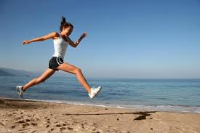
Sports Medicine 101
What are the signs of inflammation?
ICE vs. Heat
Tips on proper stretching
Sprains and Strains
Importance of hydration
Top 5 things you shouldn’t do in the gym!!

Slide 15
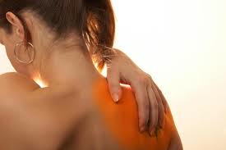
Inflammation
The body’s response to injury.
Beginning stage to healing.
5 cardinal signs of inflammation:
  Heat
  Redness
  Swelling
  Pain
  Loss of Range of Motion

Slide 16
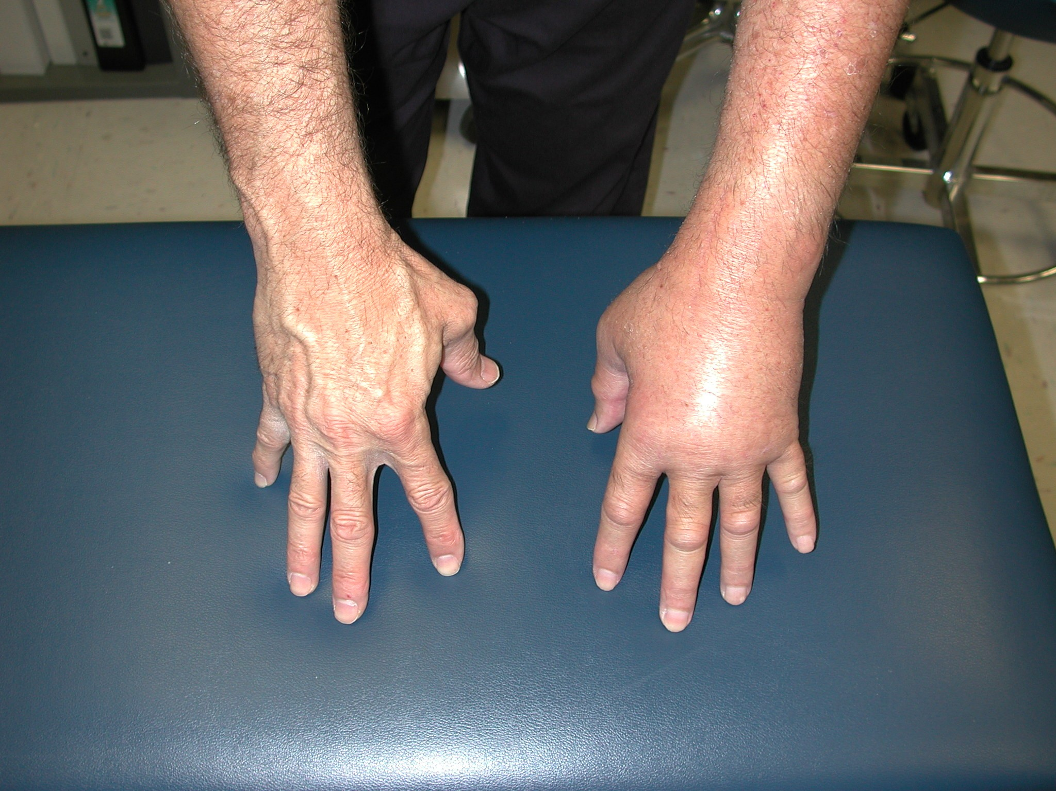

Slide 17
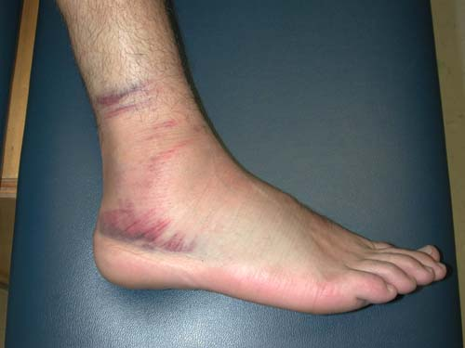

Slide 18

Ice vs. Heat
What does ICE do?
  Constricts blood vessels to decrease blood flow
    Decreases Inflammation
  Decreases muscle spasms
  Decreases pain
What does HEAT do?
  Increases blood flow to treatment area for healing
  Improves flexibility and stretching abilities
  Relaxes soft tissue (muscles)

Slide 19
Ice vs. Heat
Use Ice
Use Heat
Acute injury (new)
Presences of swelling, discoloration, and loss of function.
Pain
Contusions
First degree burns
Pain has diminished
No presence of discoloration or swelling.
Chief Complaint: stiffness, loss of ROM

Slide 20
Ice vs. Heat
Do Not Use Ice
Do Not Use Heat
  Raynaud’s Disease
  Impaired Sensation
  Peripheral Vascular Disease
  Uncovered wound
Fever present
Impaired sensations
Infection
Open wound
Peripheral Vascular Disease

Slide 21
Ice vs. Heat
ICE
HEAT
Ice Pack – 15-20 Minutes
Ice Bath – 15-20 Minutes
  For extremities
Ice Cup (massage) 7-10 Minutes
RICE
Moist Heat Packs - 15-30 Minutes
Warm Bath (100-105dg)
  15-20 minutes
Dry Heat Pad – 15 -20 Minutes

Slide 22
Tips on Stretching

Slide 23
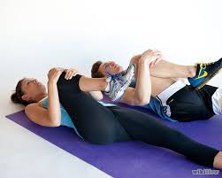
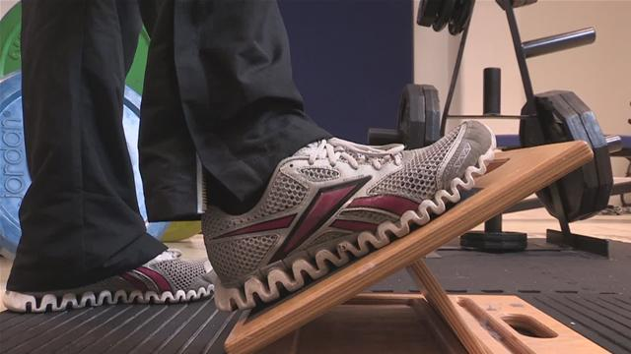
Stretching
How does a muscle work?
  Muscle guarding – Protection
Stretching muscles means you are lengthen nerves too

Slide 24
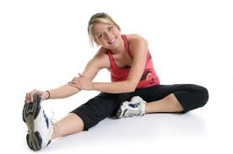
Tips on Proper Stretching
Do not bounce!
Slow steady hold. Hold for at least 20 seconds. Repeat 3-5 times.
Stretches are more effective after a warm up.
Protect your joints when stretching.
Breathe normally when stretching.
Cool down and stretch post exercise.
You shouldn’t be in pain. Go until you feel a moderate stretch and hold it. Repeat. Each repetition you should go further.

Slide 25
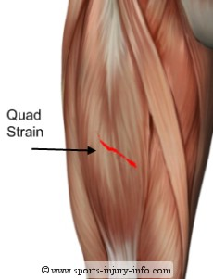
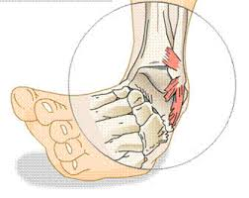
Sprains and Strains
Sprains
  Damage to a ligament or joint capsule
  Ligament connects bone to bone
  Cartilage material
  Most commonly seen in sprained ankles
  Inflammation
Strains
  Damage to a muscle
  Muscle is overexerted or over trained
  Pain with movement of injured muscle.
  Sometimes associated with discoloration.
  Inflammation
*Special Tests and Manual Muscle Tests are performed to diagnose between the two injuries.

Slide 26
Sprains and Strains
How to treat sprains?
How to treat strains?
R.I.C.E
  Rest Ice Compression Elevation
Brace
Control inflammation
Ice
Light stretching
Wraps, neoprene sleeve
Light usage/cardio
No acute massages

Slide 27
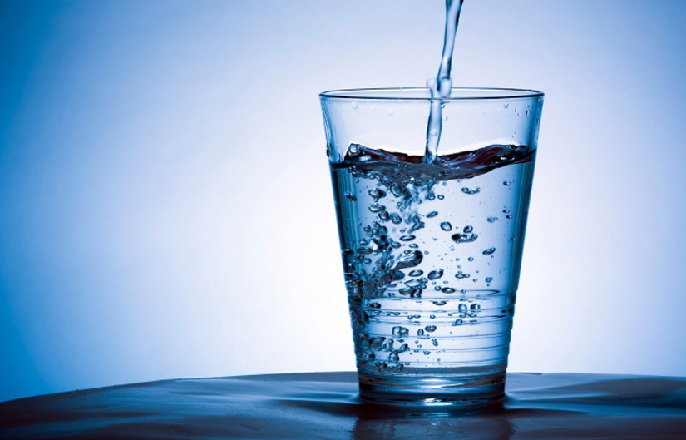
Importance of Hydration
H20 Facts!
How much to drink?
Muscles and Brain = 75% water
Blood = 82% water
Water makes up 60-70% of your body weight.
75% of Americans are chronically dehydrated.
Through your kidneys, electrolytes and toxins are managed to allow for proper body functions.
Muscles cells = 75% water
Fat Cells = 15% water
Women – 92 oz of water
Men – 124 oz of water
20 to 35% of water comes from foods we eat.
Don’t rely on your thirst!
Drink more when exercising or if you’ve been in the heat.
Drink until urine is clear.

Slide 28
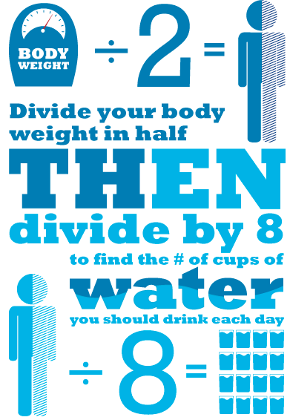
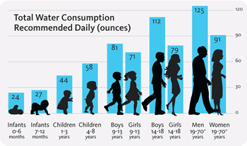

Slide 30
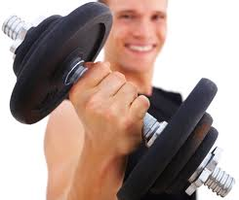
What Not To Do in the Gym!
Don’t lift weights without a proper warm up!
Stay away from exercises above your head especially if you have a history of injuries to your shoulder/rotator cuff. These may cause shoulder impingement.
Decrease weight/resistance and maintain proper form. Quality vs. Quantity.
Act your age. “Im 17 I can lift way more……”
Sets, Reps, Weights = only increase one at a time. Don’t over do it. Higher reps and lower weights to prevent injuries.

Slide 31

What Questions Do You Have?
Injury question?
Exercise question?

