Slide 1



Tuscola High School
Registration Information
2020-2021

Slide 2
Tuscola’s Counselors
Kari Russell (A-G)
Teresa Heinz(H-O)
Julia Plott (P-Z)
Tuscola’s Career Coach
Andrew Johnson

Slide 3
Course of Study Book – online at www.ths.haywood.k12.nc.us
    Prerequisite
    Class Availability
    Course Description

Slide 4
Registration Sheets
Registration sheets will be given out in homeroom today
– Wednesday - February 26th.
They are DUE to homeroom teachers
– Monday - March 2nd.
For AP or Honors courses – we will check if you meet pre- requisites.
Parent & Student MUST SIGN registration form for it to be complete!
Students MUST choose 4 Alternates that they are happy with
Counselors will take registration sheets and create schedules based on student choices

Slide 5
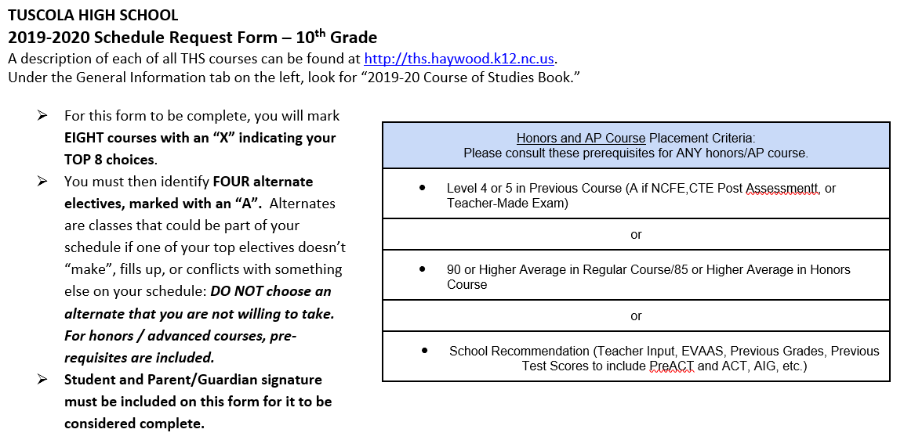
Registration Sheet
Prerequisites are listed in box for reference!
Students make their choice with an “X”
Students must make alternate choices with an “A”

Slide 6
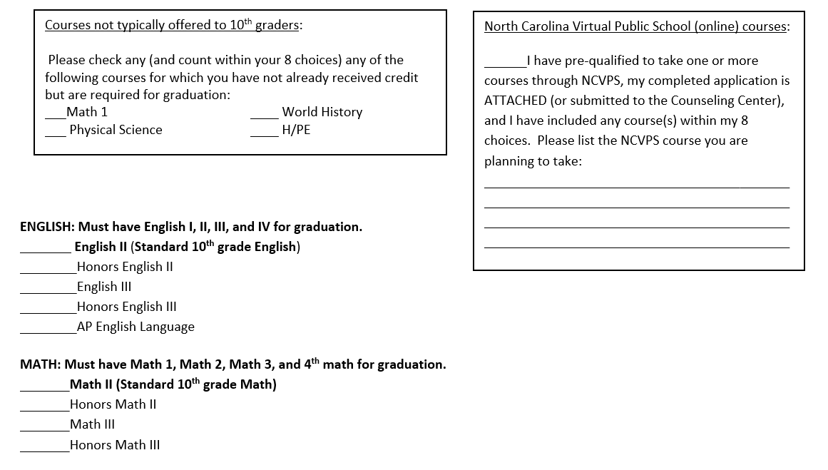
Choosing Courses
Make sure you mark HCC, NCVPS, or other courses needed in boxes!
If students do not have a completed registration sheet with parent signature by March 2nd – courses will be chosen for you.

Slide 7
Schedule Changes
Students cannot change selections after registration is complete unless one of the following criterion is met:
Incorrect Placement
Meeting Graduation Requirements
Balancing of classes and protection of the integrity of the master schedule.

Slide 8
NCVPS Courses
Classes for Regular, Honors, and AP
10th, 11th, and 12th grade students
Online Applications on THS website
  Must be turned in with registration sheets to the Homeroom Teacher on Monday - March 2nd. .
NCVPS classes are taken at THS in D10
Students must:
  Pace themselves
  Ensure that they have completed assignments
  Communicate with online teachers for any questions or concerns

Slide 9
HCC
Career & College
Promise (CCP) Courses
Jessica Honeycutt
will be here February 26th
to meet with students
to choose courses.

Slide 10
HCC
Career & College
Promise (CCP) Courses
Applications are DUE March 2nd!
Returning HCC students MUST complete returning student application.
New HCC students must complete a pre-qualifying eligibility application!

